Slide 1

Silent Disparities
Identifying Gender Bias in Medical Outcomes
BAN 5600 – Big Data
Presented by : Joash, Kubra, Pragathi

Slide 2

Overview
Large-scale bias detection using MIMIC-IV EHR data.
ML models + fairness metrics to evaluate gender equity.
Consistent disparities identified.

Slide 3
Dataset Overview
MIMIC-IV ICU dataset (40K+ patients).
Tables: demographics, diagnoses, procedures, labs, outcomes.
Adult patients only (18+).

Slide 4
Modeling Framework
Framework: PySpark on Databricks.
Second Platfrom : Google colab
Models: Logistic Regression, Decision Tree, Random Forest, GBT.
70/30 Train-Test Split; fixed seed.

Slide 5
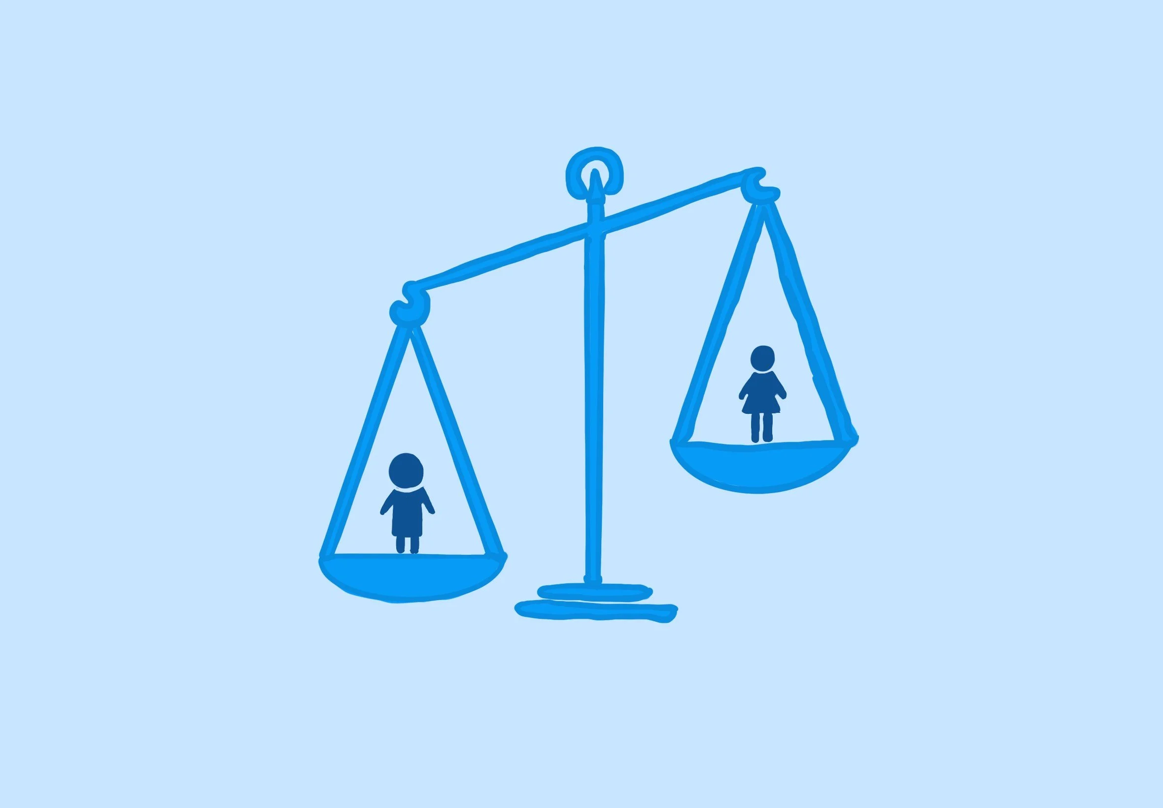
Findings

Slide 6
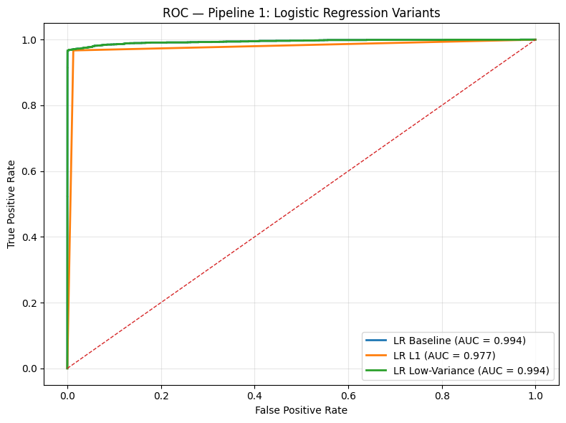
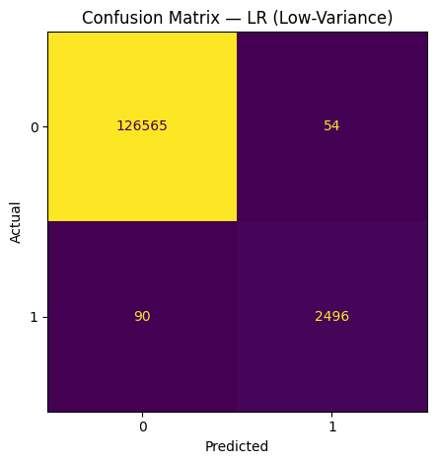
Logistic Regression
False Negatives: 90 → best sensitivity
False Positives: 54 → excellent precision when predicting death
Feature cleaning removed 173 noisy dimensions → reduced overfitting while retaining signal

Slide 7
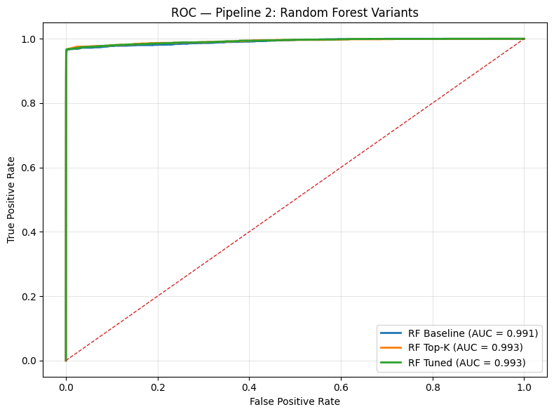
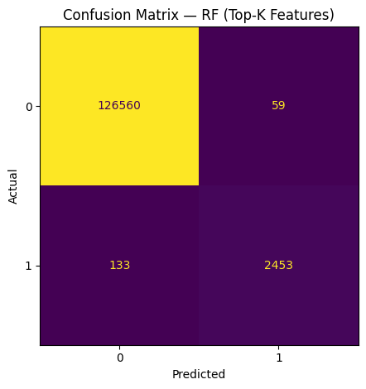
Random Forest
FN: 133 | FP: 59 → slightly higher errors but still strong performance
Feature ranking focuses training on most predictive clinical attributes

Slide 8
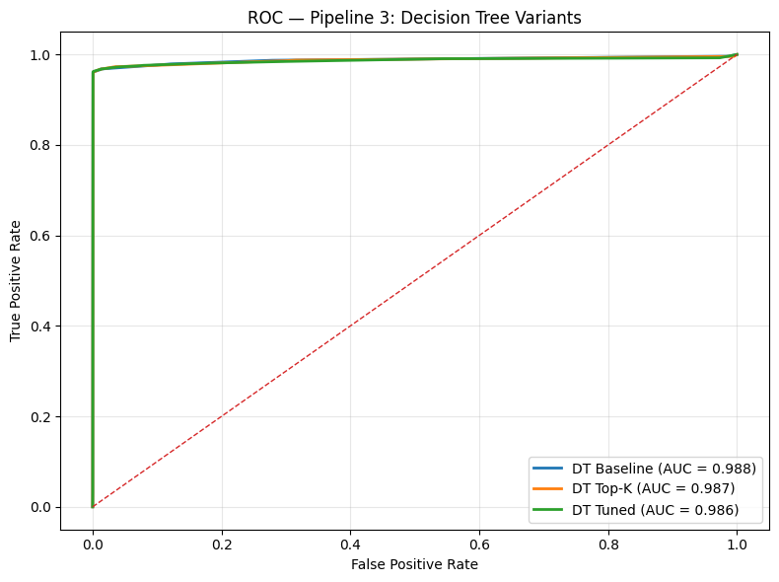
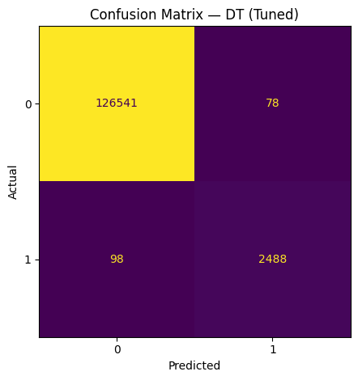
Decision Tree
FN: 98 | FP: 78 → more incorrect death predictions
Most interpretable model — clinicians can easily understand decision logic

Slide 9
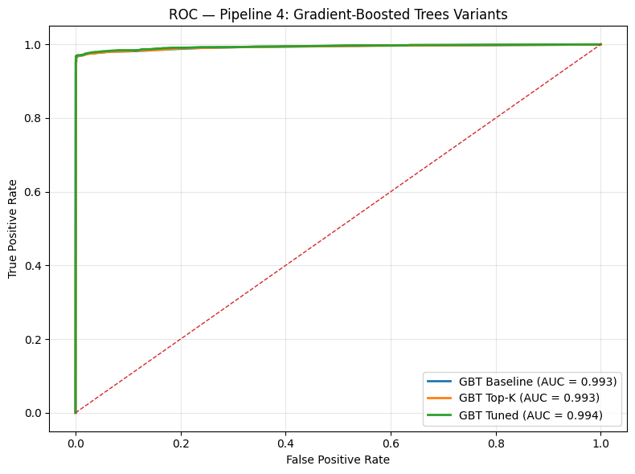

Gradient-Boosted Trees
FN: 115 | FP: 62 → good balance of recall & precision
Boosting reduces mistakes iteratively → better minority detection

Slide 10
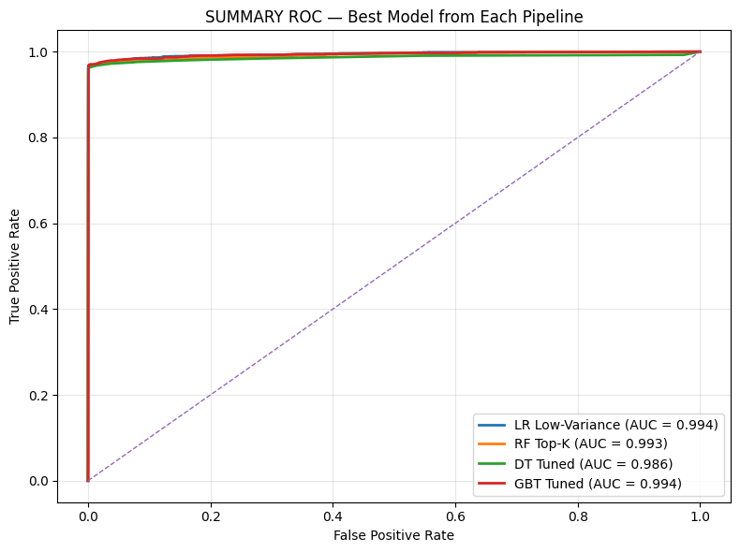
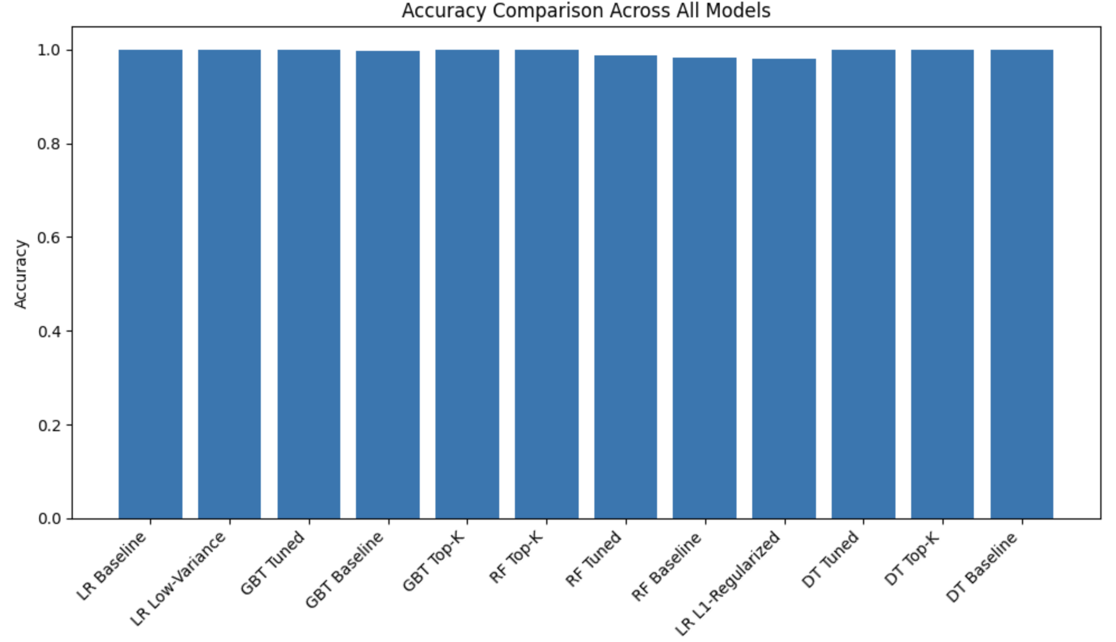
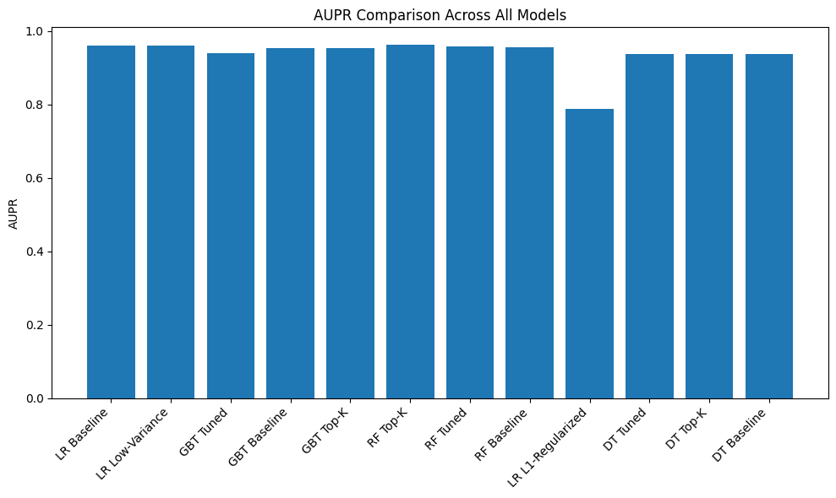
Summary: Best Model Comparison

Slide 11
Critical Literature Insight
Despite extensive literature, research remains incomplete.
Women live longer than men, reducing raw mortality signals.
Longevity masks systemic underdiagnosis or treatment gaps.
Outcome parity does not guarantee care parity.

Slide 12
Interpretation
Machine learning shows fairness statistically.
However, systemic disparity may exist in access and diagnosis.
Longevity may hide real clinical inequities.

Slide 13
Limitations
Single hospital dataset.
Hashing reduces feature interpretability.
No race/socioeconomic intersection analysis.

Slide 14
Future Work
Intersectional bias analysis.
SHAP & LIME explanations.
External validation with multi-center datasets.

Slide 15
Conclusion
Strong predictive models with fair outcomes.
Model fairness does not imply equity in healthcare delivery.
Policy and clinical reforms still required.

Slide 16

Thank You

